Slide 1
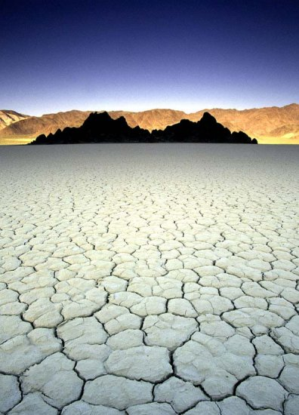
Death Valley
Notes:
The name may be a little off-putting, but Death Valley is a park geologists are particularly fond of because it is perhaps the most geologically diverse in America.

Slide 2
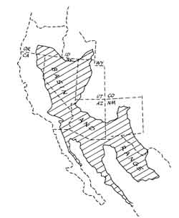
Death Valley
San Andreas Fault
Notes:
The park’s geologic diversity is related to its location within a part of the Basin and Range province that is fairly close to the San Andres Fault. Death Valley National Park is therefore shaped by both extensional and translational tectonics.

Slide 3
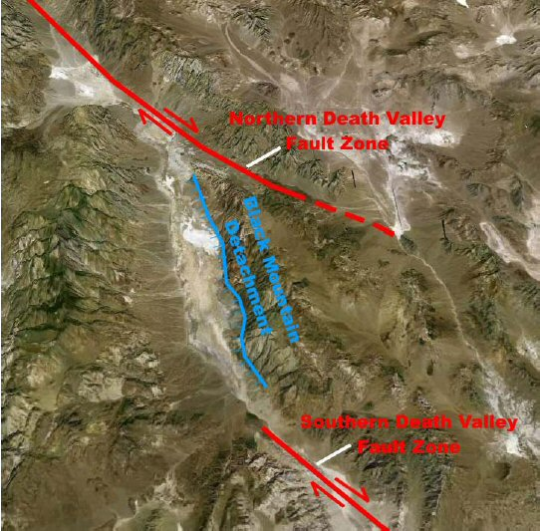
Notes:
Two major sideways-moving, or strike-slip faults, dominate the structure. Like the San Andreas, both the Northern and Southern Death Valley Fault Zones are right-lateral strike-slip faults. That means objects on the other side of the fault will be displaced to an observers right as the movement occurs along the fault.

Slide 4
Notes:
Notice that as motion on these two faults occurs, a zone of extension emerges that corresponds to Central Death Valley. This extension not only created Death Valley, but it also enabled the emplacement of a core complex along the Black Mountain Detachment.

Slide 5
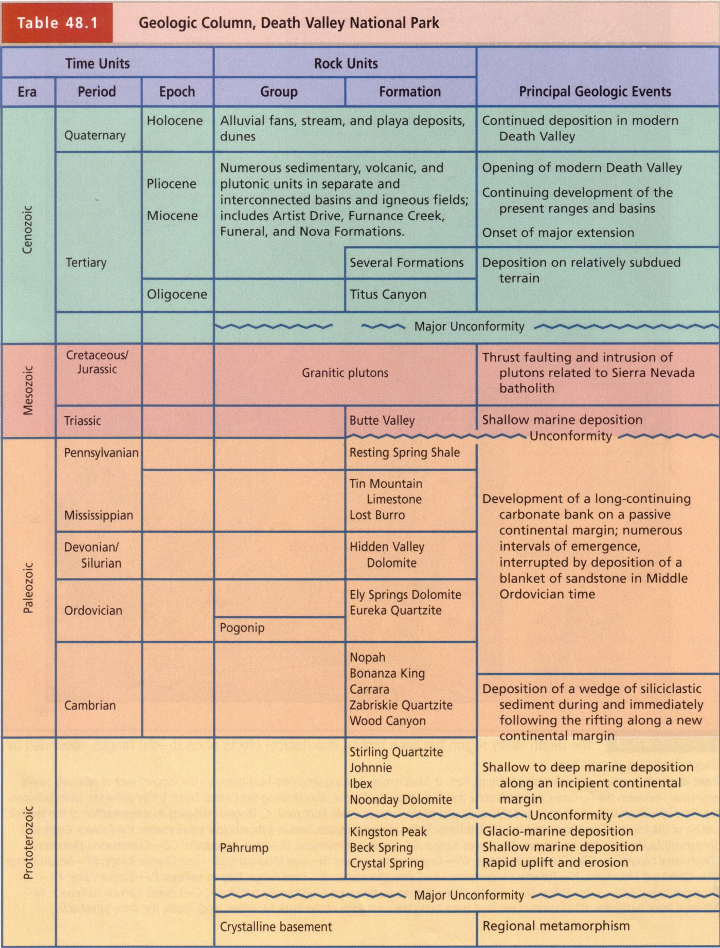
Notes:
As is usually the case with core complexes, very old, deep-seated rocks are brought to the surface. Death Valley exposes an amazing spectrum of rock ages going back to the middle Proterozoic.

Slide 6
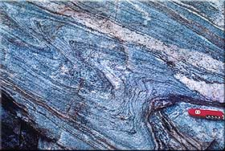
1.7 by migmatite basement
Notes:
The oldest rocks are 1.7 billion year-old migmatites. Migmatites are rocks that lie between igneous and metamorphic because some of the minerals in the rock melted, but not all. Partial melting allows migmatites to fold easily. Such conditions are typically found near the crust’s base in the cores of mountain ranges.

Slide 7
Notes:
Separated from the mylonite basement by a major unconformity lie a series of largely sedimentary rocks starting with the Late Proterozoic Pahrump group.

Slide 8
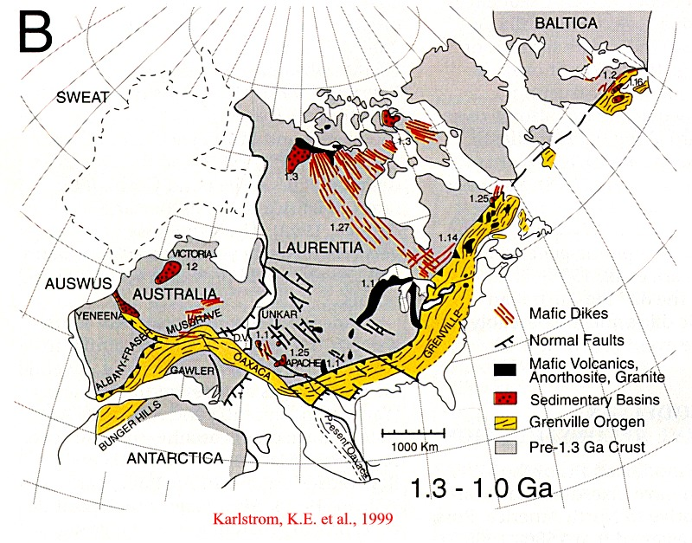
Death Valley
Notes:
Pahrump Group sediments were deposited in and along the rift valley which eventually separated Rodinia.

Slide 9
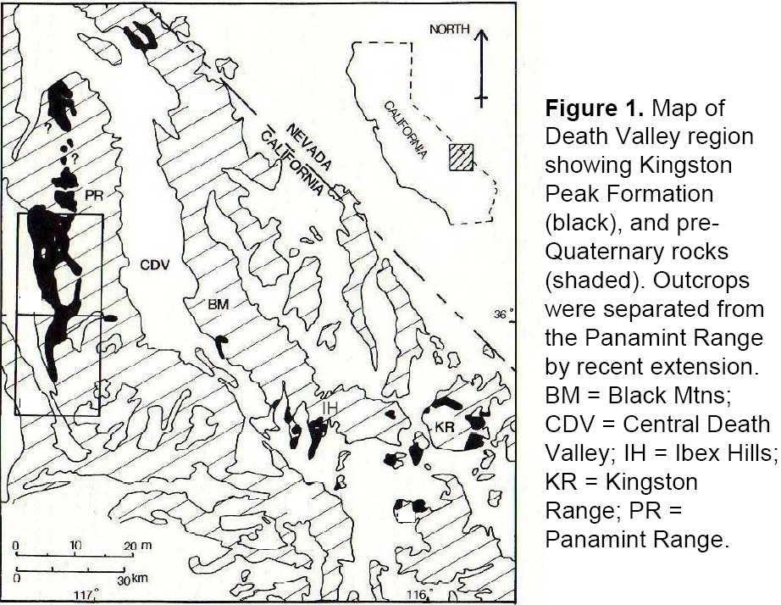
Notes:
The most interesting formation within the Pahrump Group is the Kingston Peak formation which outcrops mostly in the Panamint Range on the west side of the valley.

Slide 10
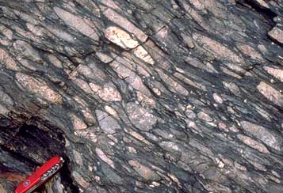
1.2 - 0.8 b.y. Pahrump Group (Kingston Peak formation)
Notes:
Metamorphism of the Kingston Peak produces one of my favorite rocks – stretched pebble conglomerate. I love how the flattened cobbles and pebbles give you a sense of the enormous compressive forces that created this rock.

Slide 11
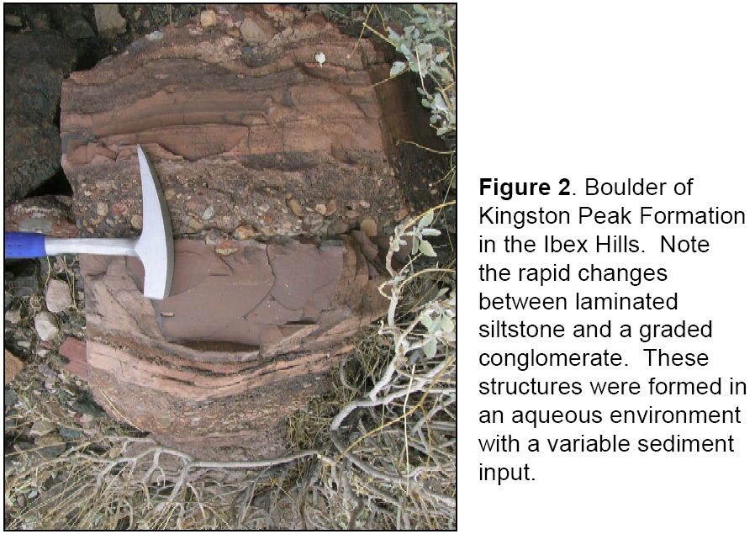
Notes:
Non-metamorphosed portions of the Kingston Peak Formation show rapid changes in sediment grain size and …

Slide 12
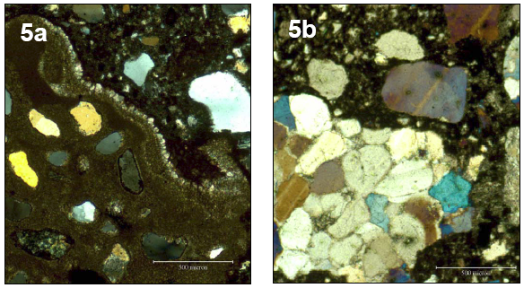
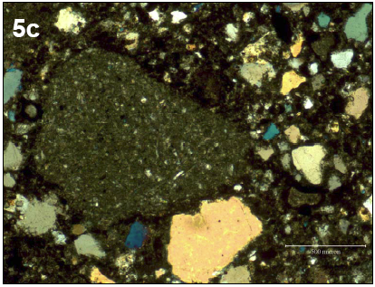
Notes:
… great variety in the rock types comprising the particles. These characteristics imply diverse depositional mechanisms including calm water sedimentation, mud flows and, most importantly, glacial till. The Kingston Peak formation holds some of the world’s best evidence for an intense Late Proterozoic ice age.

Slide 13
Notes:
Deposited unconformably atop the Pahrump Group is the Noonday Dolomite.

Slide 14
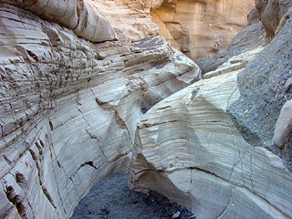
Late Proterozoic Noonday Dolomite
Notes:
Like limestone, dolomite is a carbonate. The difference is that dolomite contains Mg whereas limestone contains Ca. The Noonday dolomite was deposited by algae on a stable continental platform.

Slide 15
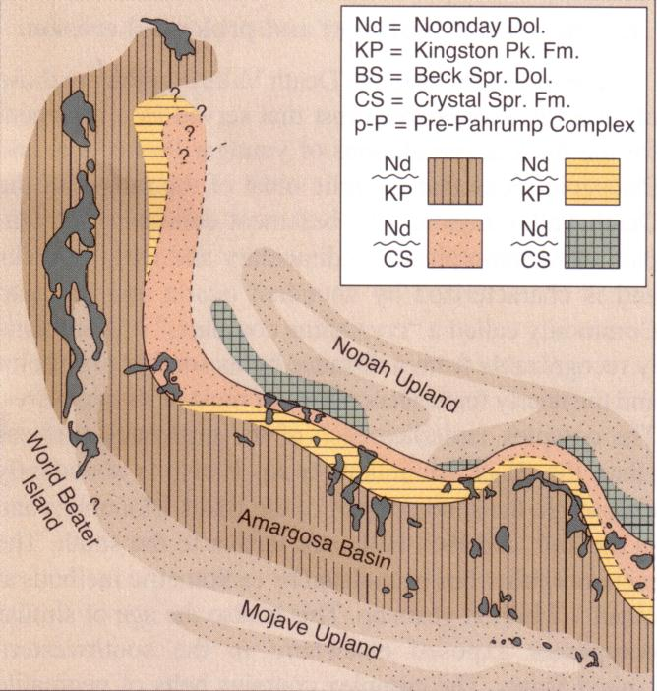
Notes:
The relationship between the Noonday and Pahrump group suggests that the Pahrump group deposited in a failed rift, also known as an allochogen.

Slide 16
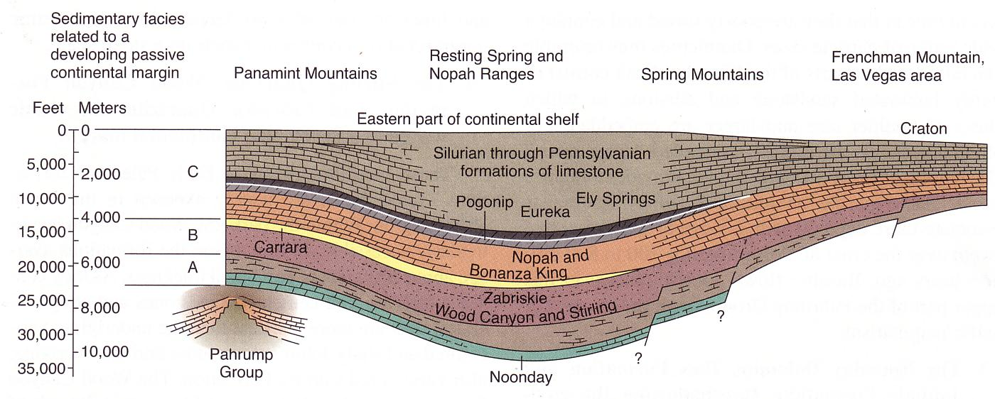
(ALLOCHOGEN)
Notes:
Note the position of the allochogen represented by the Pahrump Group to the Noonday which lies at the base of a thick sequence of Paleozoic sediments.

Slide 17
What tectonic setting is indicated?
Notes:
If the Paleozoic sediments are mostly carbonates, quartzite and shale, what tectonic setting is indicated?

Slide 18
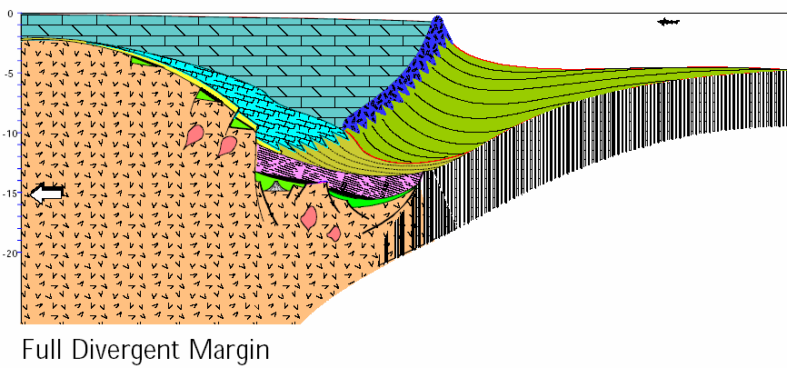
ALLOCHOGEN
FULL DIVERGENT CONTINENTAL MARGIN
Notes:
Remember this diagram from the Wilson Cycle? Yes, it’s our old friend the divergent continental margin. Note the various rift-created basins at the base of the sedimentary sequence that failed to produce oceanic crust. These are allochogens.

Slide 19
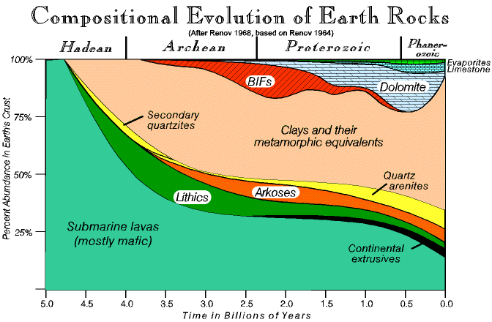
Notes:
As we transition from the Proterozoic to the Phanerozoic, changes in the ocean’s chemistry and the evolution of shell-making organisms eventually make limestone the dominant carbonate rather than dolomite.

Slide 20
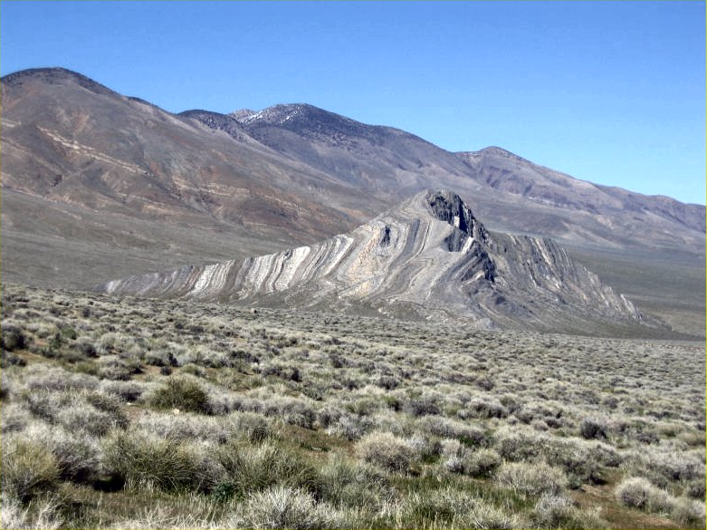
Striped Butte
Notes:
The contrast between the light limestone and dark shale at Striped Butte clearly shows the continuous layering of the Paleozoic DCM strata.

Slide 21
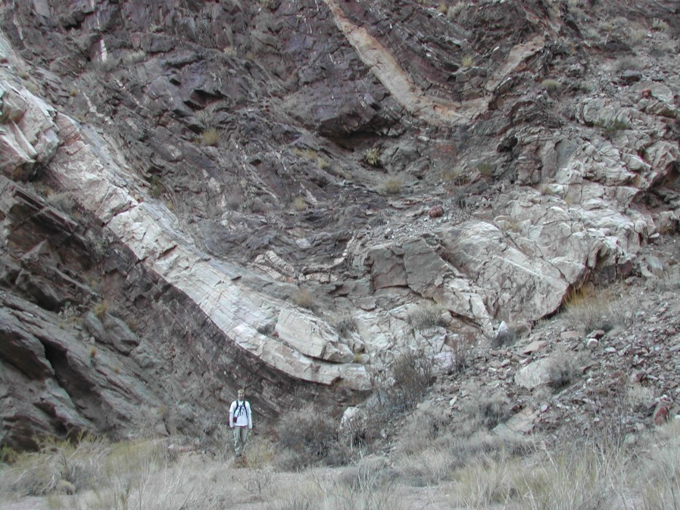
Notes:
The continuous and widespread Paleozoic layers make for good reference – clearly showing folds produced during Mesozoic compression. Here we see a syncline exposed in Monarch Canyon in the Funeral Mountains of the northeast part of the park.

Slide 22
Notes:
Mesozoic folding was associated with thrust faulting which accompanied the emplacement of the Sierra Nevada Batholith.

Slide 23
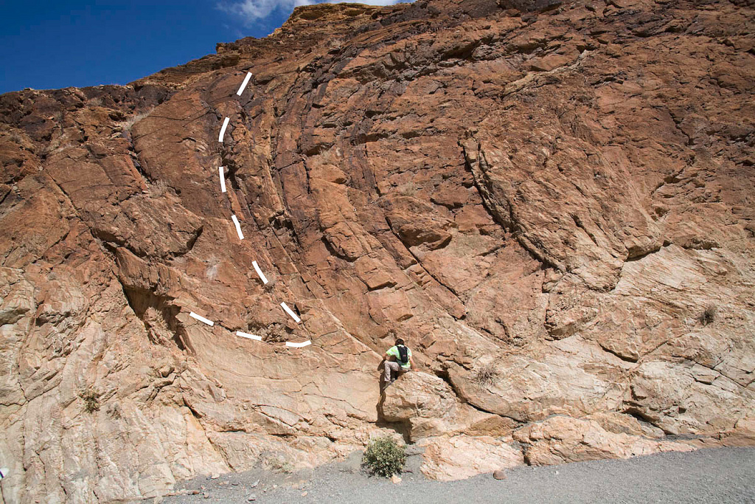
Notes:
In Mosaic Canyon there is a good example of the overturned folds which are typically associated with thrust faulting.

Slide 24
Notes:
Moving into the Cenozoic we see a diverse assortment of volcanic, plutonic and largely terrigenous sedimentary rocks. These of course were not folded by Mesozoic compression but they are greatly affected by faulting.

Slide 25
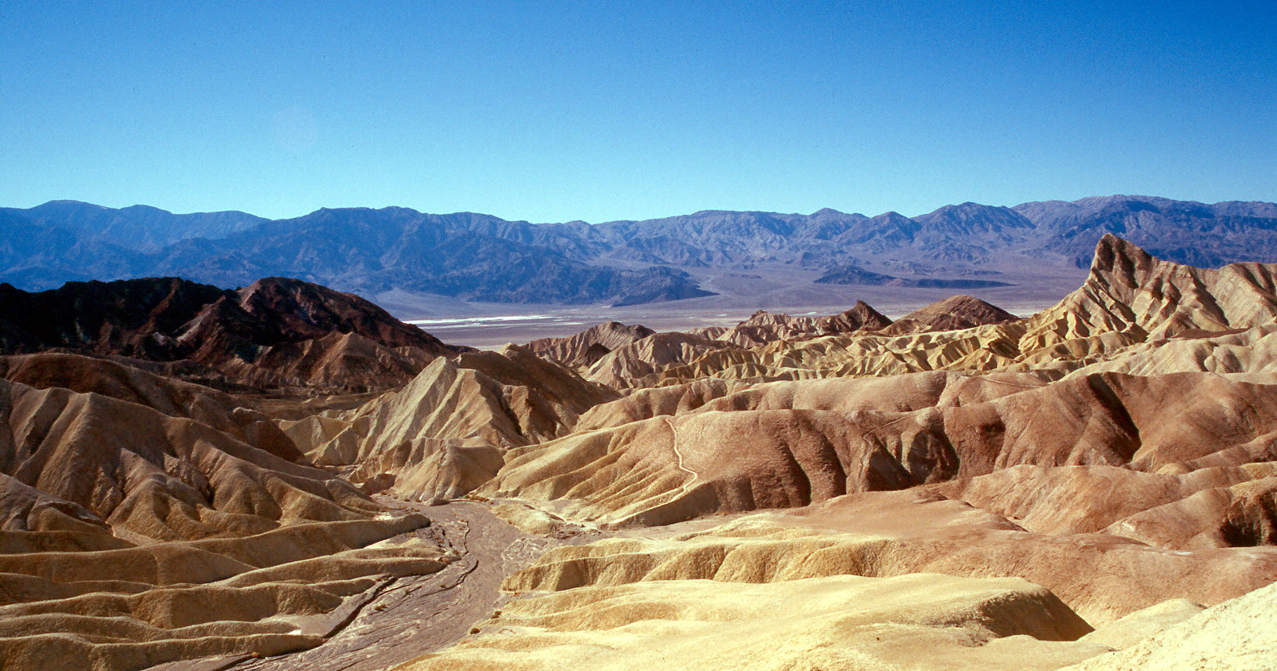
Zabriskie Point
Notes:
These are exposed beautifully at Zabriskie point, a popular drive-up view point …

Slide 26
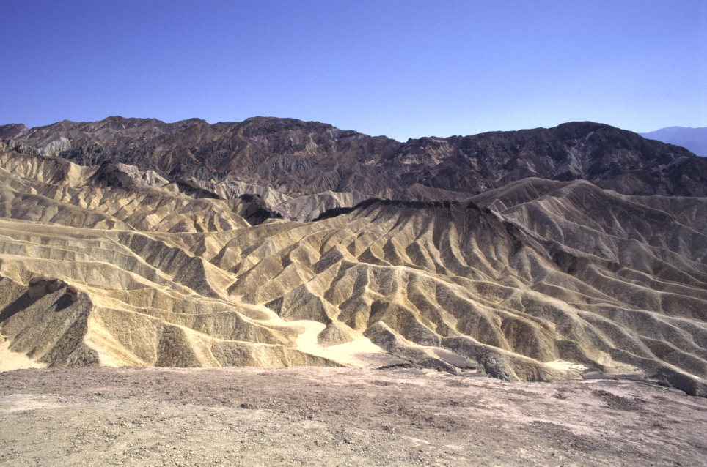
Badlands topography at Zabriskie Point
Notes:
… where rapid uplift and erosion of the relatively soft sedimentary rocks has created a network of closely spaced drainages referred to as badlands topography.

Slide 27
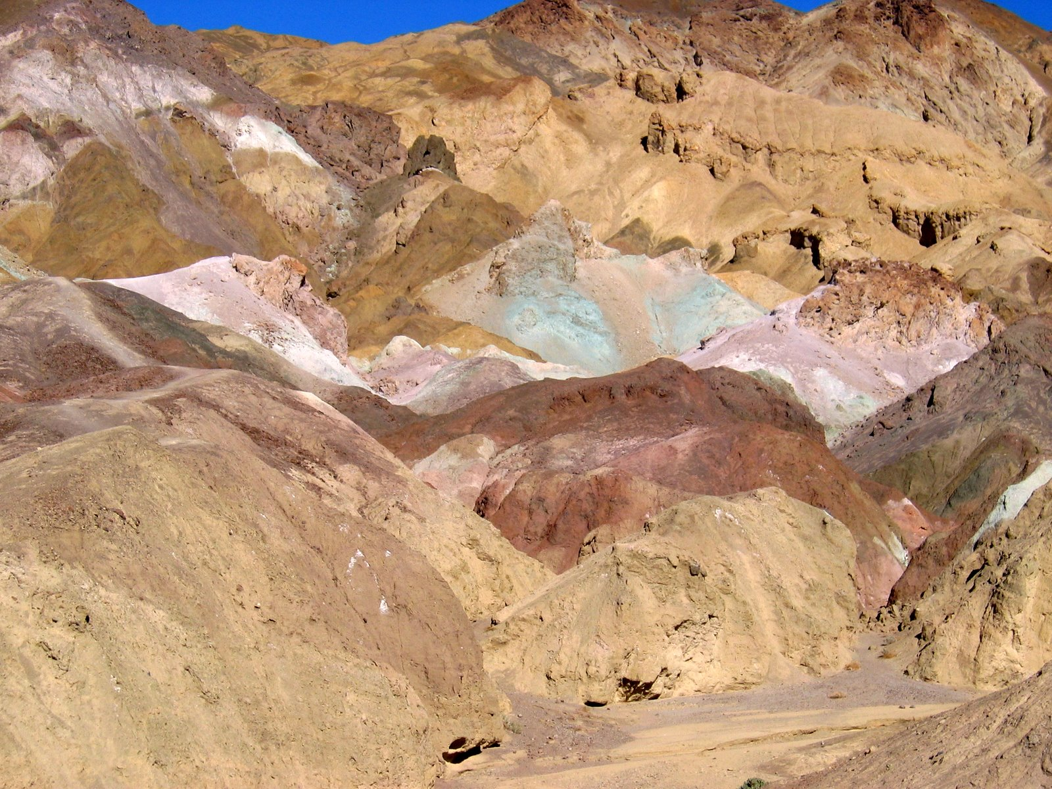
Artist’s Palette
Notes:
Artists Palette is another popular Death Valley viewpoint which showcases the Cenozoic rocks. Here cemented gravel, playa deposits and volcanic debris are chemical weathered and hydrothermally altered into a variety of colors. Virtually all the colors here are attributed to various iron compounds. Brick-reds and pinks are due to the presence of ferric (Fe II) oxides. Darker browns and black indicate ferrous (Fe III) oxides. Iron hydroxides and oxide-hydroxides are usually represented by shades of golden to pale yellow, but where there are altered volcanic ash deposits, striking green colors may occur.

Slide 28
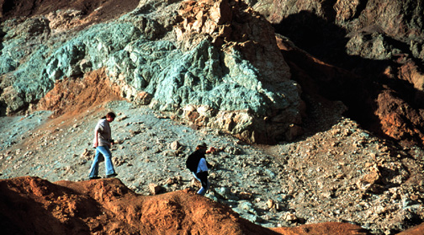
Notes:
The green colors are often mistaken for copper compounds, but they would have been mined years ago had any copper been present.

Slide 29
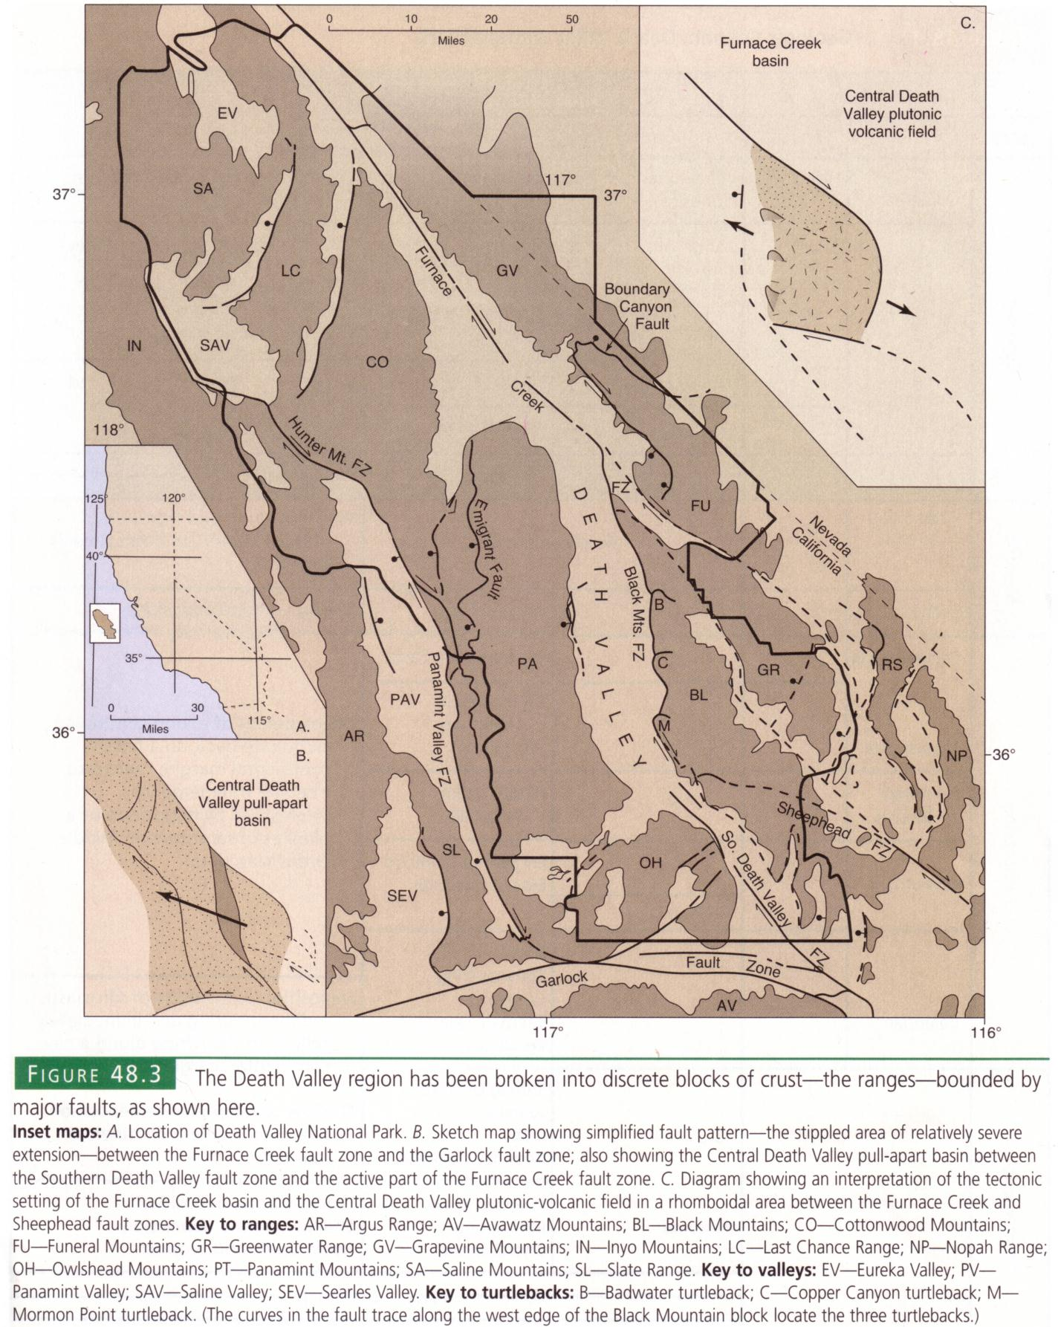
Notes:
The hydrothermal alteration so prominent at Artists Pallet is linked to heat associated with magmatic activity triggered by the thinning of the crust due to stretching across central Death Valley. Remember that motion along the park’s two major strike slip faults is directly responsible for the Central Death Valley pull-apart basin.

Slide 30
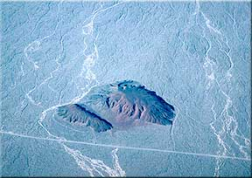
Right or left lateral?
Notes:
The relationship between faulting and volcanism in Death Valley is nicely illustrated by the distribution of relatively recent basaltic volcanic centers. They tend to occur along faults which provided conduits for the basaltic magma to reach the surface. Here a cinder cone is displaced by a strike slip fault. Is the sense of displacement left or right? Remember, ask yourself: In which direction did the other side move?

Slide 31
91m in 400,000 years = ? mm/year
Notes:
Did you say right? I hope so. Now try this, the cinder cone is about 400,000 years old and the fault has displaced it 91 meters since it formed. What is the slip rate in mm/year?

Slide 32
91m / 400,000 years = 2.3 mm/year
Notes:
Well it comes out to about 2.3 mm/year or about an inch every ten years. That’s pretty good by geologic standards. For comparison, the mighty San Andreas moves roughly two inches per year.

Slide 33
Notes:
Displacement along extension-produced normal faults is even more rapid than that of the strike-slip faults here.

Slide 34
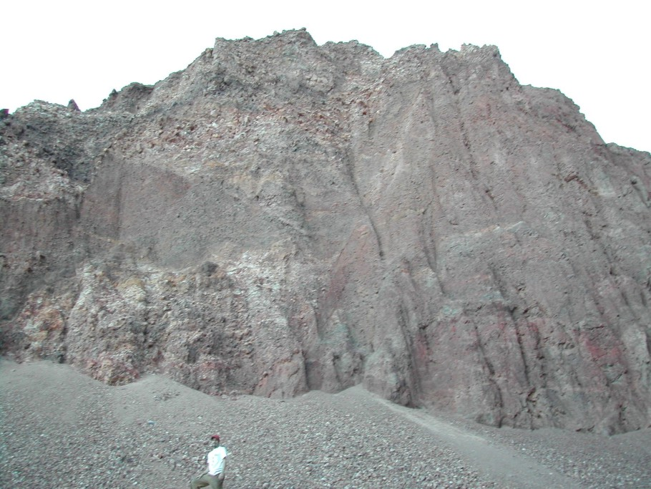
Notes:
Normal faults in Death Valley, like this one exposed near Badwater, have slip rates between 1 and 9 mm per year. That rate appears to be accelerating as indicated by….

Slide 35
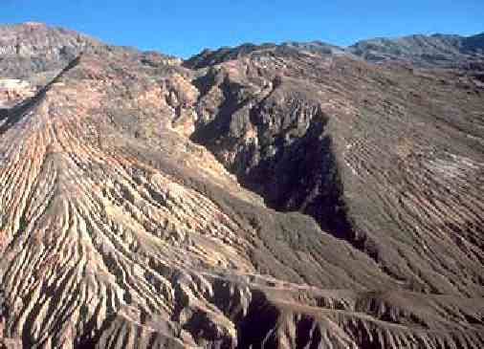
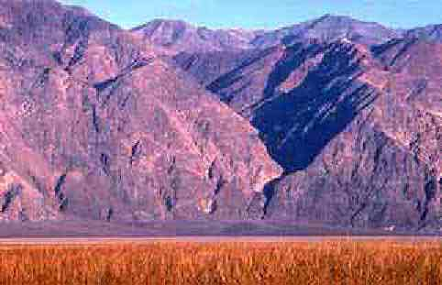
wineglass
canyons
Notes:
…. wineglass canyons. When viewed from the correct angle, most canyons in the Black Mountains resemble wineglasses. Alluvial fans form the glass's base while the narrow canyon behind it broadens with increasing elevation to form the stem and bowl. Wineglass canyons indicate recent uplift. Their steep "stems" form by erosion of the canyon floor immediately behind the fault soon after an uplift event. With time, stream erosion and mass wasting processes widen the canyons to form bowls. Later uplift events re-form the stems while erosion continuously widens the canyon upstream. In the Black Mountains, many of the canyons begin with dry falls at their mouths and therefore have near-vertical stems.

Slide 36
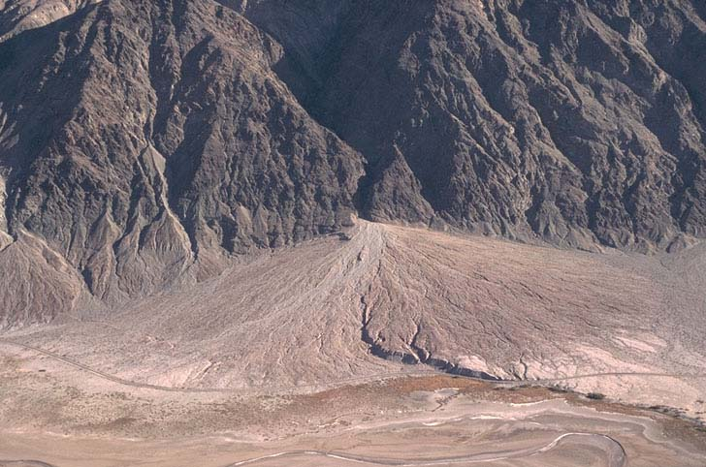
Notes:
Actually, I think they look a lot more like…

Slide 37
Notes:
… Martini glass canyons.

